Slide 1

MEDPLUS
ATHIRA ARUN
NIDHIN V S
NAKUL P
PREMDEV A P

Slide 2
CONTENT
Objectives
Introduction
Scope
Approach
Use case diagram
HLD
LLD
Solution
Result
Advantage
Disadvantage
Future Work
References

Slide 3
. OBJECTIVES
To assist old people in reminding them about medicines.
To track the location of nearby chemist shops.

Slide 4
INTRODUCTION
MedPlus is a Web app to assist people with their medical routine.
It will store all the medications prescribed by the doctor and helps maintain the stock till the time needed.

Slide 5
It assist people in reminding them about medicines
It helps in updating their current stock of the required medicines.
It also tracks the location of the nearest chemist shop.

Slide 6
OUT OF SCOPE
It is not possible to check whether the medicine is out of
stock.

Slide 7
APPROACH
Agile principle
Scope out and prioritize projects
Diagram requirements for the initial sprint
Construction/iteration

Slide 8
Release the iteration into production
Production and on going support for the software release
Retirement

Slide 9
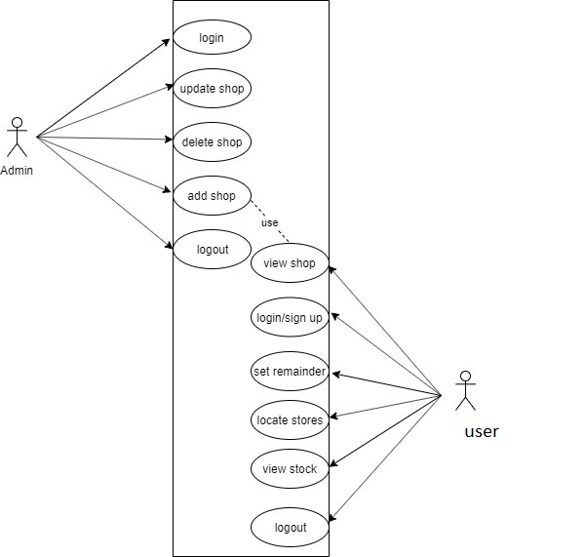
Use case diagram

Slide 10
MODULE 1
ADMIN
Admin can add medical shops.
He can view ,delete, and update details of each medical shop.

Slide 11
MODULE 2
USER
User can signup to the application.
He can add remainder by saving details such as name of the medicine, quantity to be consumed,and time schedule for taking medicines.
User gets notification whenever he needs to take the medicine.

Slide 12
He can view the stock details.
The stock details are updated automatically when the user consumes the medicine.
When the stock goes below 15%,the user gets notification.
He can also track the location of nearby medical shops.

Slide 13
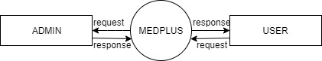
HLD level 0

Slide 14
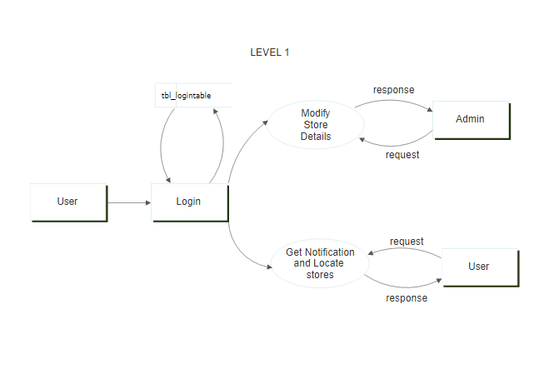
Level 1

Slide 15
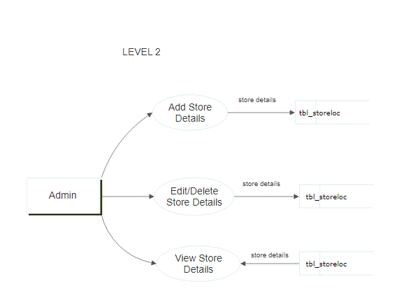
Level 2

Slide 16
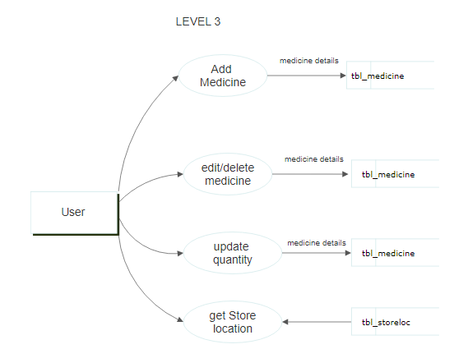
Level 3

Slide 17
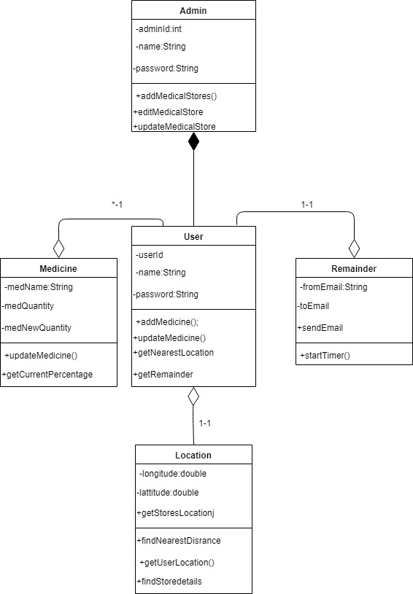
Class Diagram

Slide 18
SOLUTION
The user add details of his medicines.
He can set remainders.
Stock details are updated automatically.
The user can view all the registered chemist shops
The location of nearby chemist shops can be tracked.

Slide 19
RESULT
Notifications are send to the user in case he/she fails to take medicines.
Location of nearby chemist shops are tracked.

Slide 20
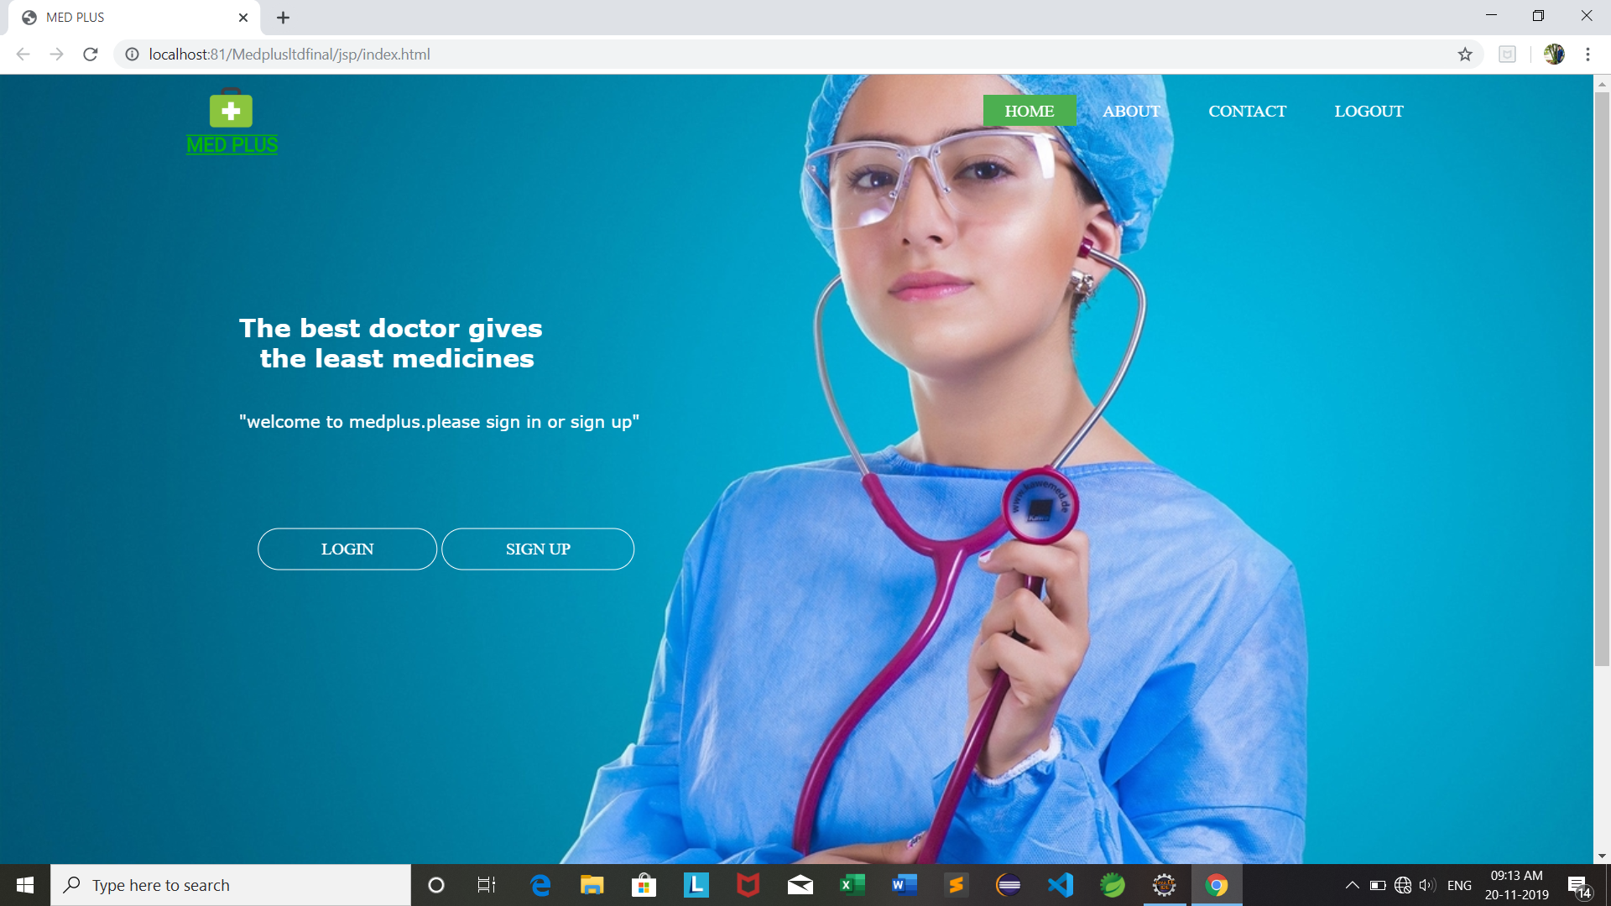
Home page

Slide 21
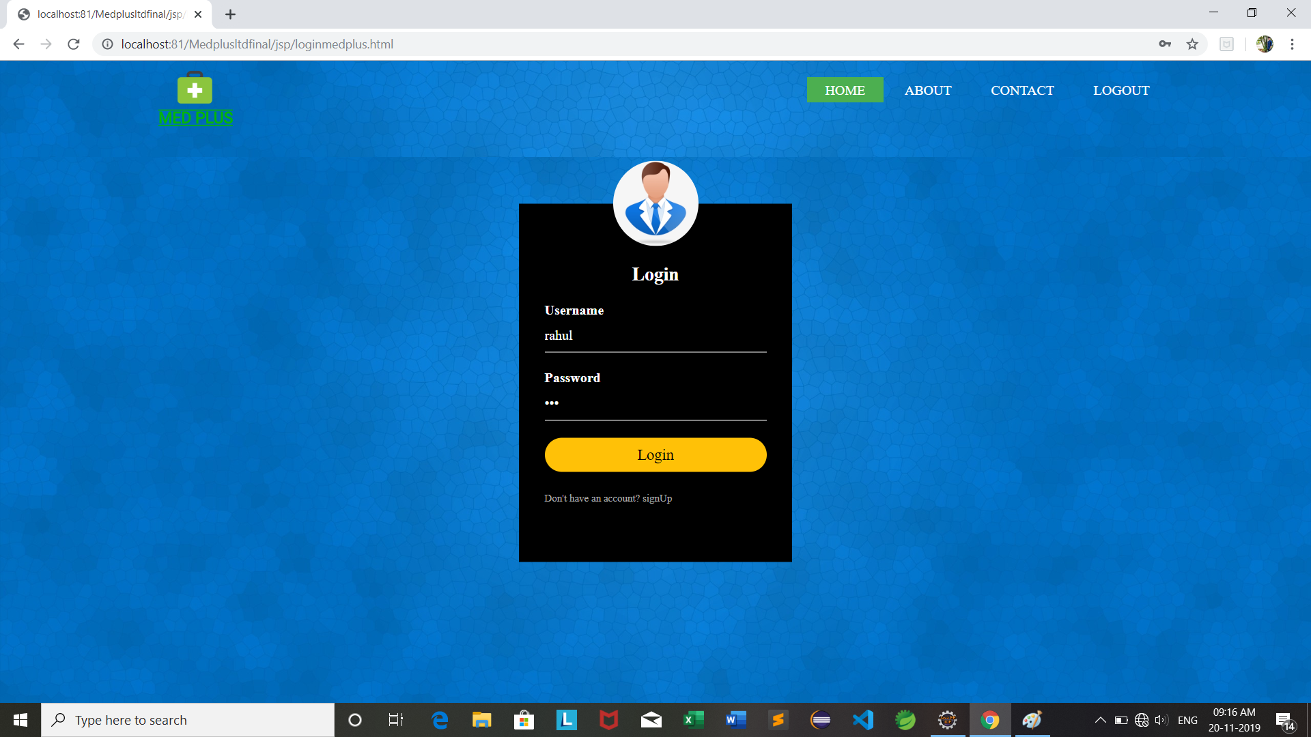
Login page

Slide 22
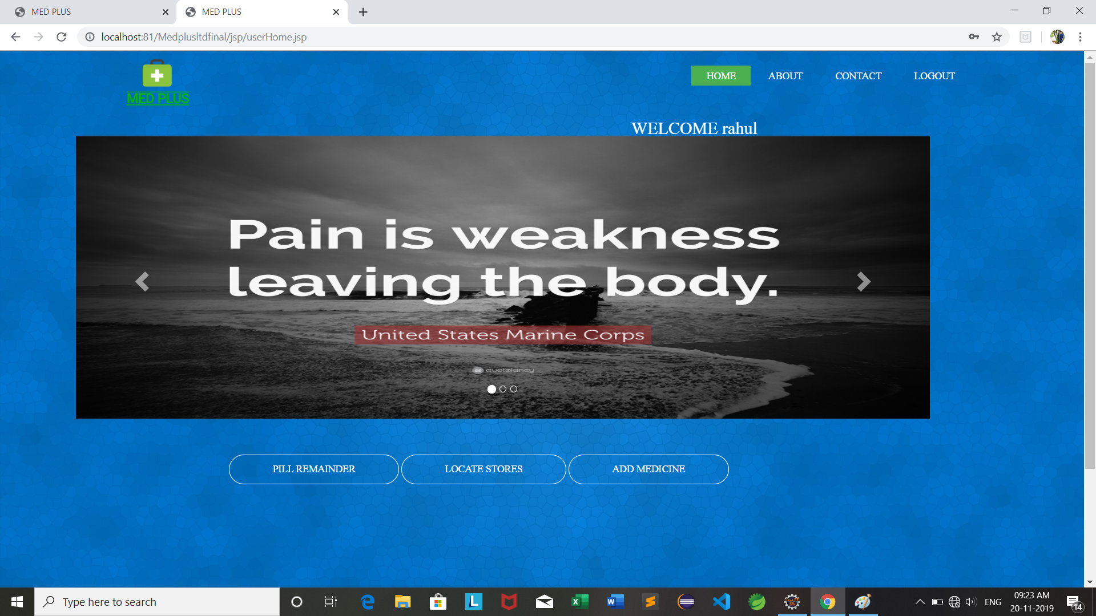
User Home

Slide 23
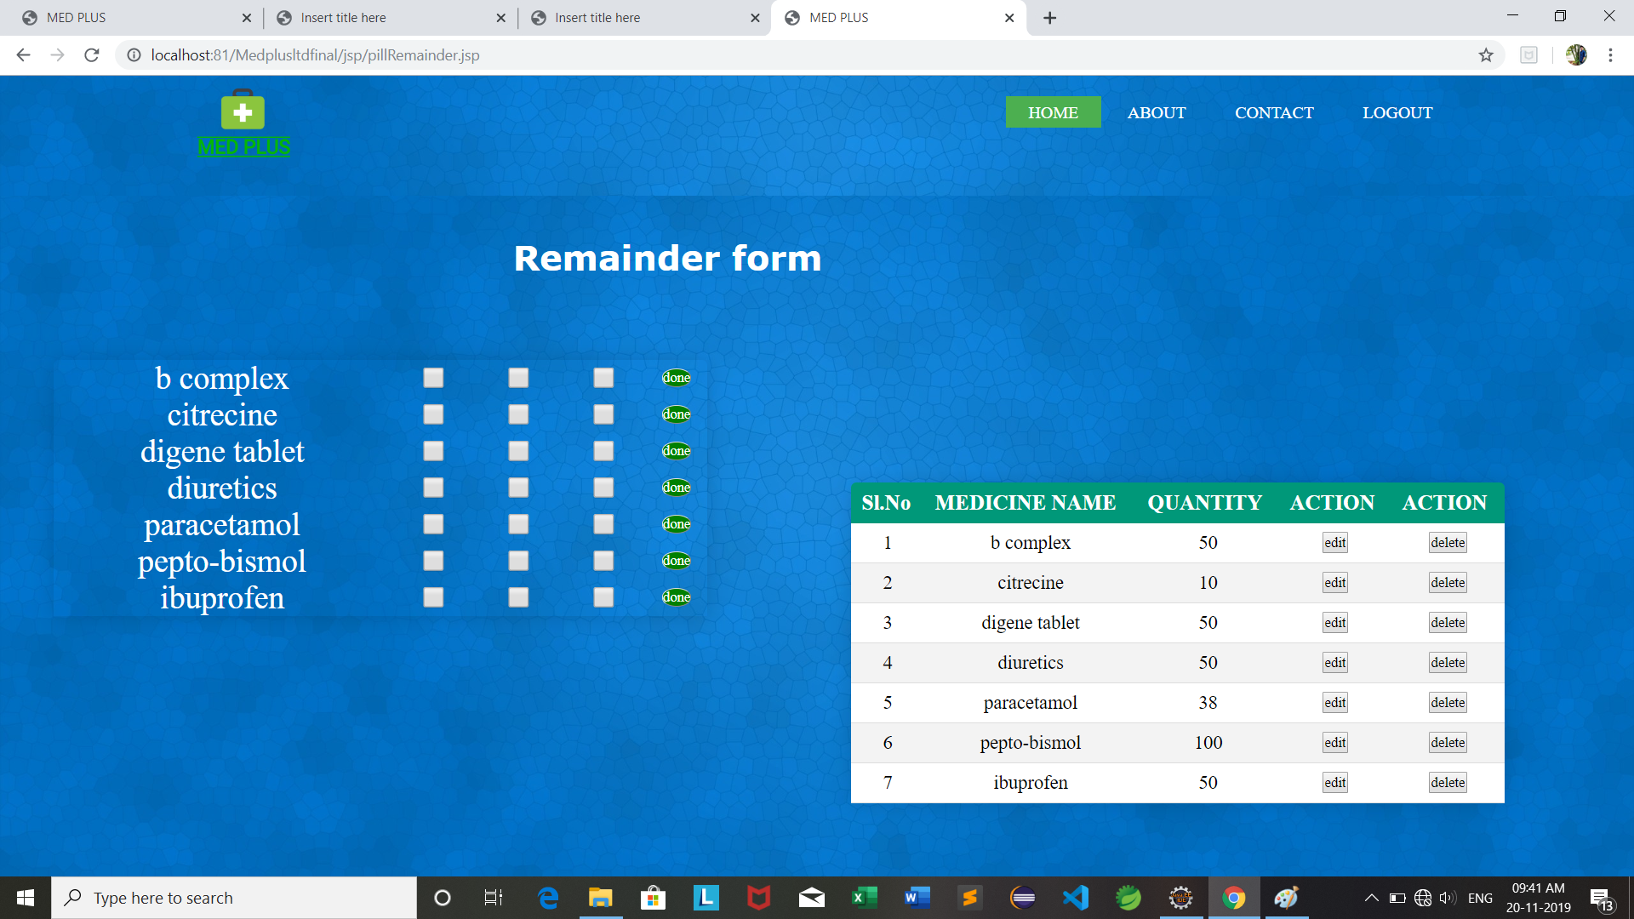
Pill Remainder

Slide 24
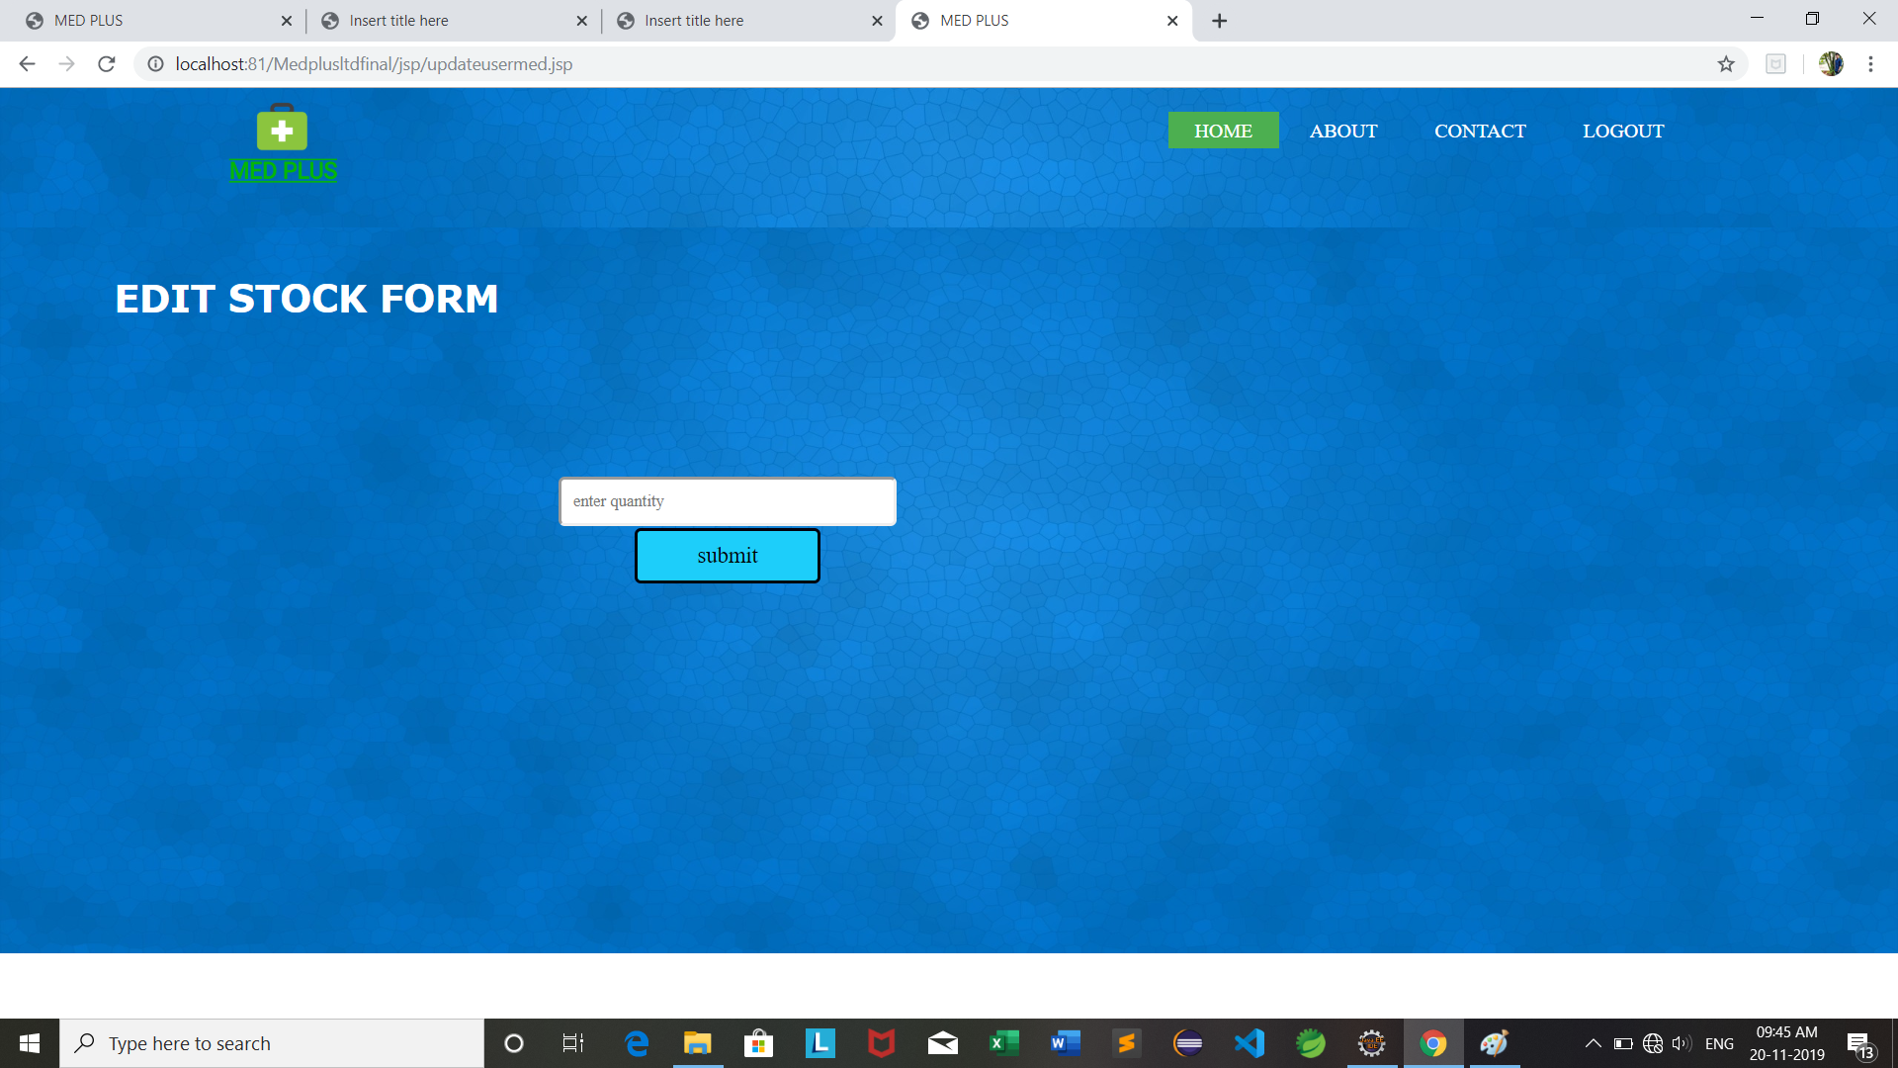
Edit Stock

Slide 25

Reminder Check

Slide 26

Remainder Check Demo

Slide 27
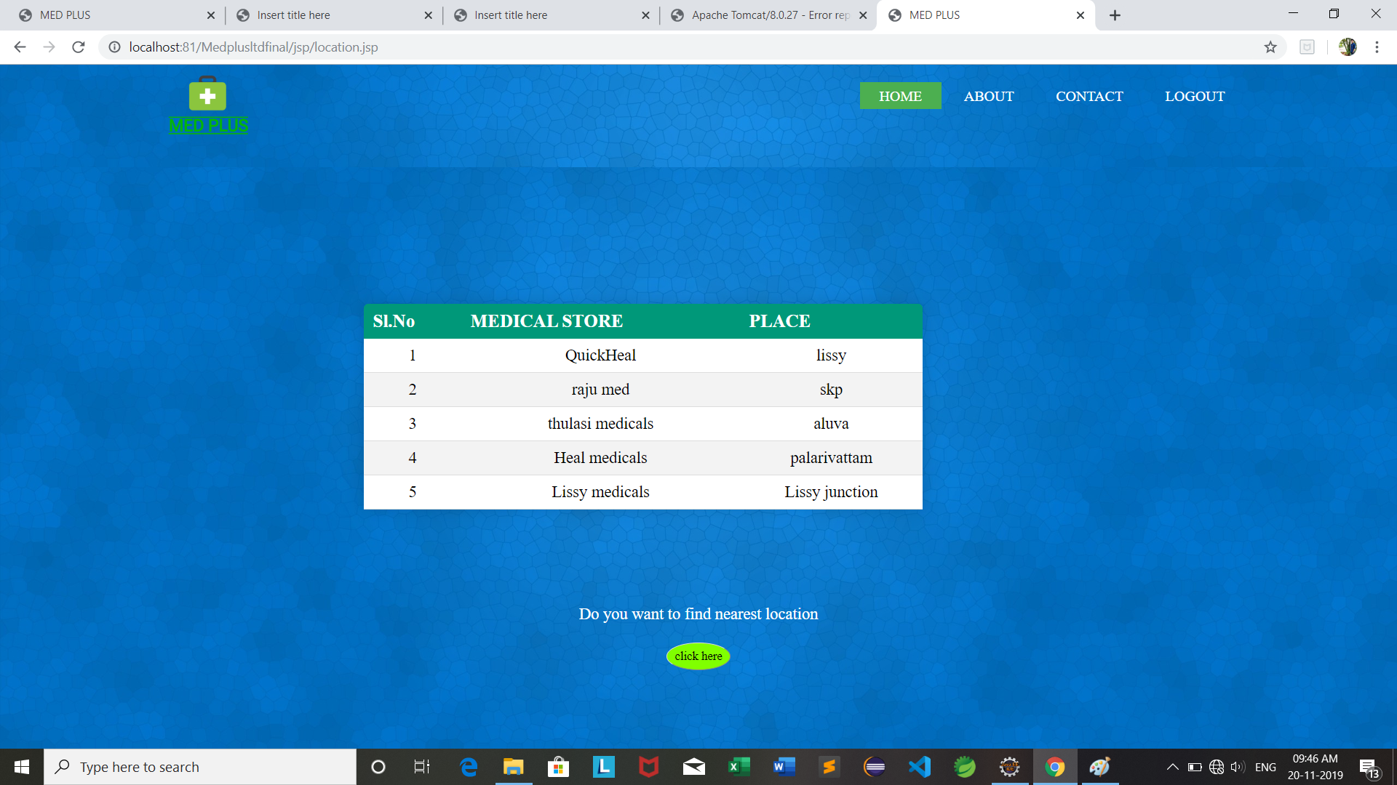
Tracking all shops

Slide 28
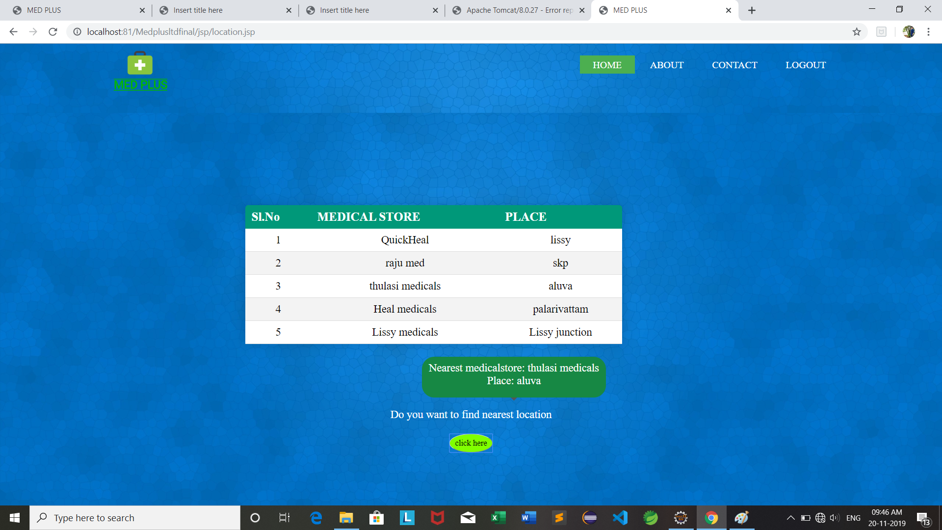
Tracking nearby shop

Slide 29
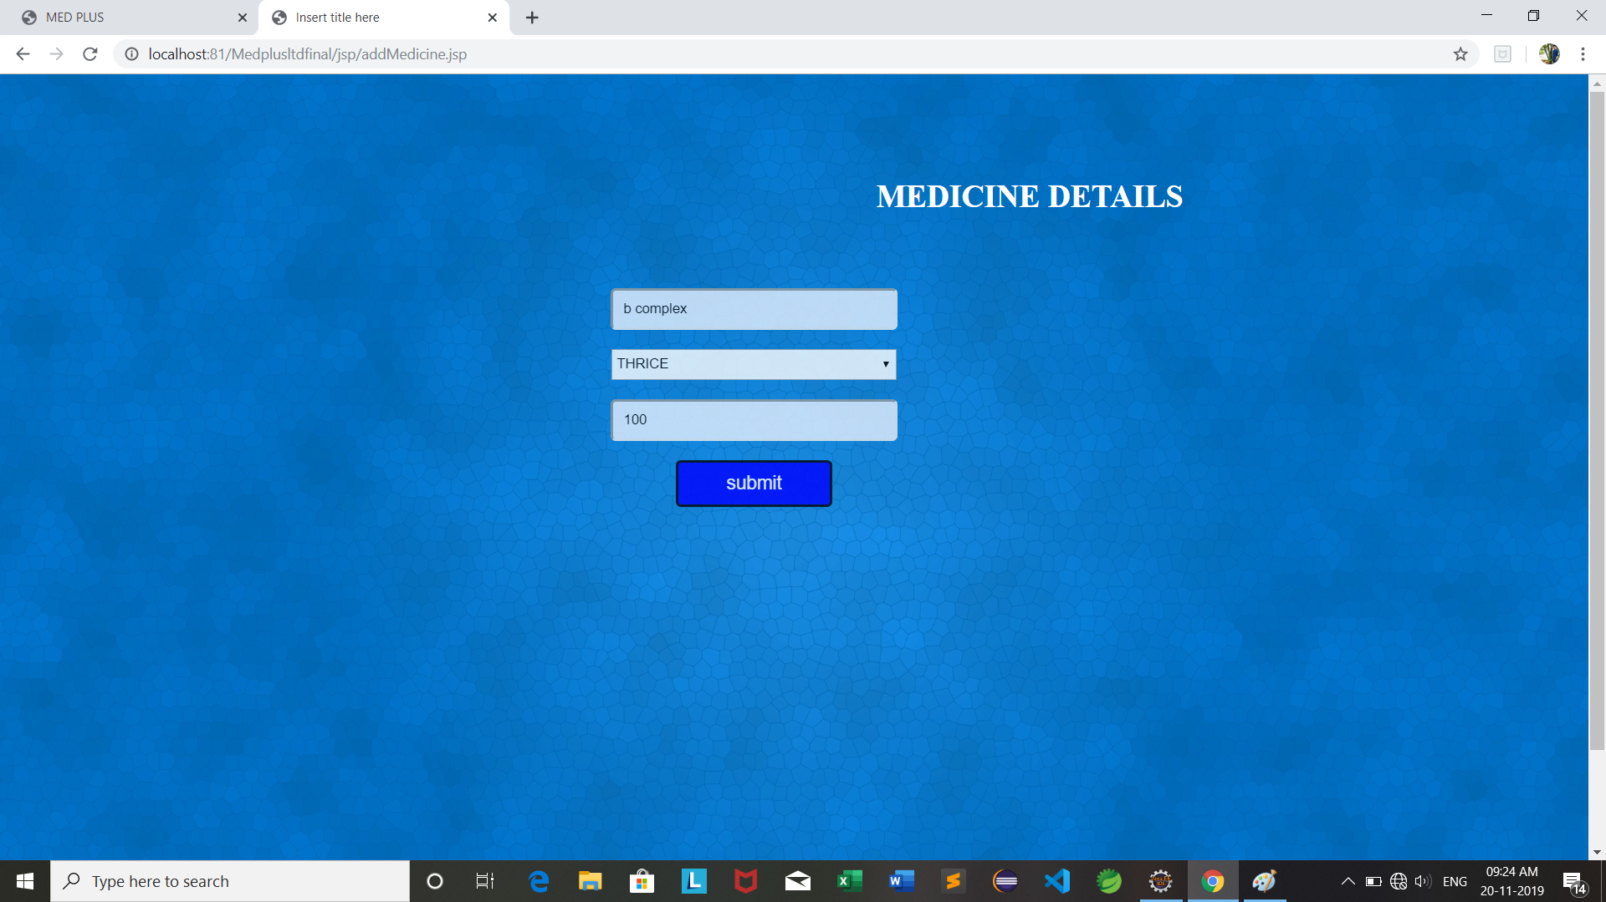
Add Medicine

Slide 30
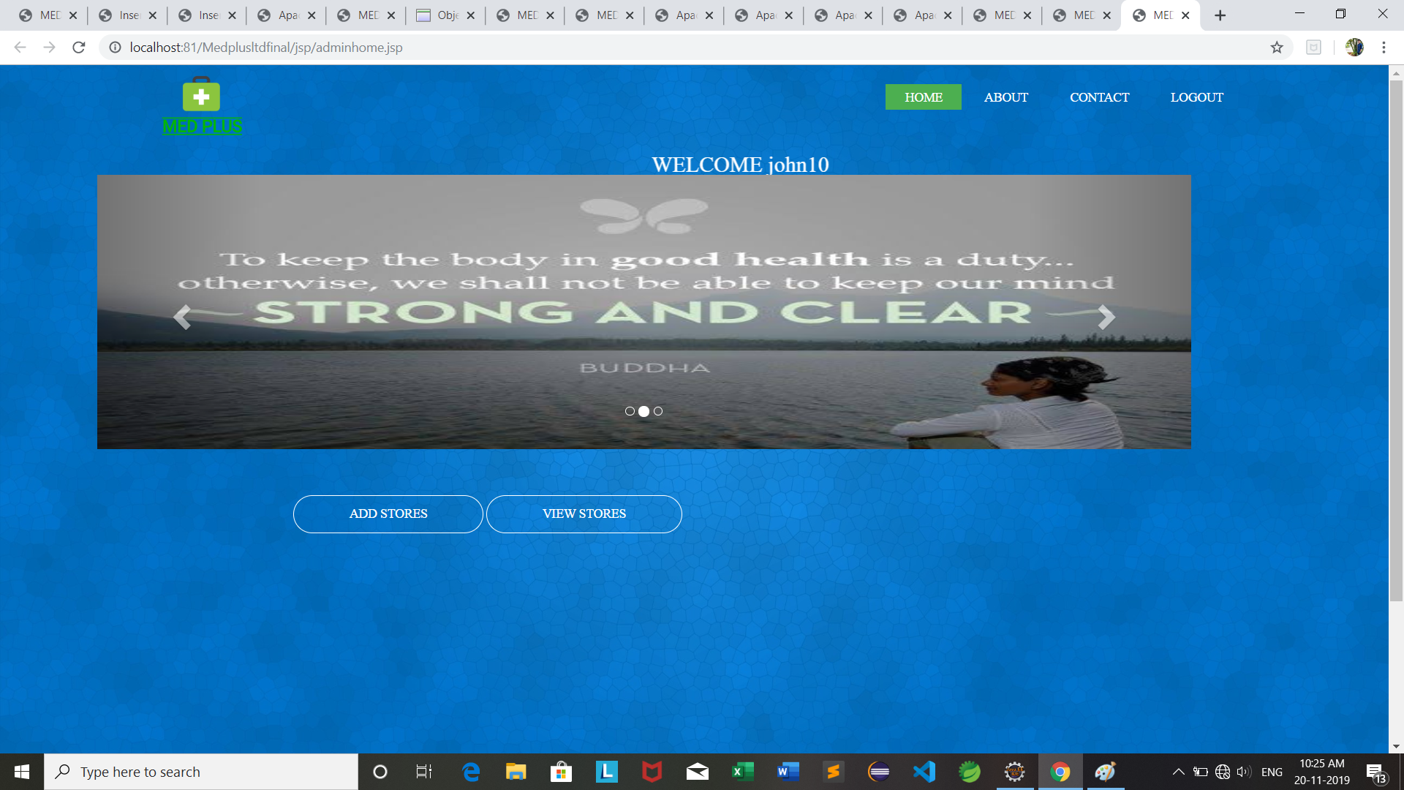
Admin Page

Slide 31
ADVANTAGES
Easy Setup – It takes a couple of minutes to setup a new user.
Improves the medical routine of the user.
Flexible Access – Patients can access from anywhere with internet access.

Slide 32
DISADVANTAGES
The application can only be used when there is internet access.

Slide 33
FUTURE SCOPE
In future online pharmacy facility can also be added to the application.
It may provide home delivery of their demanded medicine and suggesting them alternatives to that medicine in case it is unavailable or expensive for them.

Slide 34
REFERENCES
https://www.javatpoint.com
https://www.tutorialspoint.com/java/index.htm
https://stackoverflow.com/
https://www.geeksforgeeks.org/java-tutorials/

Slide 35
CONCLUSSION
In short our application provides notification for the user to take the medicine and also helps the user to track nearby medical shops.

Slide 36
THANK YOU

